Slide 1
Power
Platform
Proposed Roadmap

Slide 2
Agenda
Power Platform Overview
Current Risks
Risk Mitigation Steps
Licencing & Resourcing Needs
Appendix
  Premium Licencing Benefits
  Roadmap
  Priority Items
Notes:
Review agenda
Appendix contains supplemental information to be reviewed at leisure, deck will be shared

Slide 3
What is Power Platform?
Power Platform
Microsoft’s low-code platform designed for rapidly building customized end-to-end business solutions.
Copilot Studio
Power
BI
Power Automate
Power Apps
Power Pages
Notes:
Power Platform consists of 5 services. Since Power BI is owned by another area (Data Tech Services) and Power Pages is not currently used, we will be focusing on:
Copilot Studio
Power Automate
Power Apps

Slide 4
What is Power Platform?
Power Platform
Microsoft’s low-code platform designed for rapidly building customized end-to-end business solutions.
Agents
Flows
Apps
Copilot Studio
Power
BI
Power Automate
Power Apps
Power Pages
Notes:
Services we’re focusing on
Copilot Studio
Copilot Studio is a graphical, low-code tool for building agents and agent flows.
An agent is a powerful AI companion that can handle a range of interactions and tasks, from resolving issues requiring complex conversations to autonomously determining the best action to take based on its instructions and context.
Power Automate
With its automation capabilities, Power Automate helps you streamline your business processes and automate repetitive tasks. Its intuitive interface and many connectors allow you to create workflows with little to no knowledge of coding.
Power Apps
Power Apps is a suite of apps, services, and connectors, as well as a data platform, that provides a rapid development environment to build custom apps for your business needs.
Other services that are part of Power Platform
Power Pages
Microsoft Power Pages is a secure, enterprise-grade, low-code software as a service (SaaS) platform for creating, hosting, and administering modern external-facing business websites.
Power BI
Power BI is a collection of software services, apps, and connectors that work together to turn your unrelated sources of data into coherent, visually immersive, and interactive insights.

Slide 5
How did we get here?
Power Platform
2018
Power Apps & Power Automate services enabled
Today
3,247 apps
8,523 flows
2023
Prod rollout of Canada Ops PSHCP premium solutions
2022
Passed
1,000 apps &
3,000 flows
1st apps & flows created
2024-2025
Engaged w/ OnX & Microsoft for a Power Platform Assessment
Estimated cost savings of ~$20M/year
Notes:
2018
Journey started, first apps and flows were created
2022
We passed 1,000 apps and 3,000 flows in our tenant, showing adoption
2023
Worked with the Canada Operations team (formerly GC Business Ops) in building out their Power Apps/Automate solutions in response to the PSHCP rollout. These solutions drastically reduced wait times for callers, improved responsiveness to critical inquiries, and save the company ~$20M annually (according to former leader Errol Funk).
2024-2025
Worked with OnX (external consultant) and Microsoft on a formal assessment of our Power Platform current state to determine risks, usage, and the best path forward.
Today
We arrive at today, with over 11000 apps/flows and a defined roadmap of where we need to go from here, to address risks and mature our Power Platform offering at Canada Life.

Slide 6
Current State
Power Platform
Development
Usage
Over half of all employees
used Power Apps in 2024
2025 projection
1020 new apps
2826 new flows
>60% of all flows/apps
were created in the last 2 years
Notes:
Good amount of adoption since 2018, with development really ballooning recently. Over 60% of all flows and apps were created in the last 2 years.
Based on apps and flows already created this year, we are projecting nearly 4000 new apps/flows will be created in 2025.
In addition to development, we are also seeing a significant increase in employee usage of Power Apps. In 2024, >50% of all employees were using Power Apps at Canada Life.

Slide 7
Risks
Other risks:
12000 data gathering
PII? Criticality?
Power Platform
Category | Current Risks/Gaps |  | How to Address
Access Security | Token replay attacks Dataverse session hijacking Access from unsecure locations | → → → | IP Firewall IP Cookie Binding Conditional Access for Individual Apps, IP Firewall
Data Security | Data leakage Data exfiltration | → → | Data Loss Prevention Policies for Desktop Flows Conditional Access for Individual Apps, IP Firewall
Financial Management | Unallocated costs | → | Licencing Chargeback Model
Operations | Ungoverned & unsupported solutions Limited support No on-call support Lack of compliance retention process Inconsistent end user training & guidance | → → → | Additional Operations Resources Extended Backup, COE Starter Kit Maker Welcome Content, Pipelines, Catalog
Solution Management | Non-existent Application Lifecycle Management Inability to manage solutions at scale (aka EUC 2.0) Inefficient development | → → → | Pipelines Sharing Controls, Environment Groups, Usage Insights Catalog, Solution Checker
Notes:
We’ll go through some of the more significant risks, as well as the features or steps required to address them.
Access Security includes network and access vulnerabilities
Token replay attacks
A malicious user who tries to download data from Dataverse using a client tool like Excel or Power BI from a disallowed IP location.
Dataverse session hijacking
Malicious user copies a valid session cookie from an authorized computer.
Access from unsecure locations
Only allow trusted IP ranges or locations.
Data Security
Data leakage
A malicious user who tries to download data from Dataverse using a client tool like Excel or Power BI from a disallowed IP location
Data exfiltration
Malicious user copies a valid session cookie from an authorized computer

Slide 8
What are Managed Environments?
Power Platform
A suite of premium capabilities that allows admins to manage Power Platform at scale with more control, less effort, and more insights.
Link to Managed Environments overview

Slide 9
Risks
Power Platform
Category | Current Risks/Gaps |  | How to Address
Access Security | Token replay attacks Dataverse session hijacking Access from unsecure locations | → → → | IP Firewall IP Cookie Binding Conditional Access for Individual Apps, IP Firewall
Data Security | Data leakage Data exfiltration | → → | Data Loss Prevention Policies for Desktop Flows Conditional Access for Individual Apps, IP Firewall
Financial Management | Unallocated costs | → | Licencing Chargeback Model
Operations | Lack of support Lack of compliance retention process Inconsistent end user training & guidance | → → → | Additional Operations Resources Extended Backup, COE Starter Kit Maker Welcome Content, Pipelines, Catalog
Solution Management | Non-existent Application Lifecycle Management Inability to manage solutions at scale (aka EUC 2.0) Inefficient development | → → → | Pipelines Sharing Controls, Environment Groups, Usage Insights Catalog, Solution Checker
Premium Licencing ($)
Managed Environments
* Requires Managed Environments

Slide 10
Costs
Power Platform
Licencing
Resources
Source | # of Licences | Total Annual Cost (CAD)*
Existing Purchases & Commitments (CanOps) | 5,000 | 0.486M
Additional Required for Managed Envs | 8,000 | 0.779M
One-Time Project Cost
~$400K
Additional Annual Licencing
~$800K
Additional FTEs
2
* Monthly cost/licence is $8.11

Slide 11
Costs
Power Platform
Licencing
The Ask
Resources
Source | # of Licences | Total Annual Cost (CAD)*
Existing Purchases & Commitments (CanOps) | 5,000 | 0.486M
Additional Required for Managed Envs | 8,000 | 0.779M
One-Time Project Cost
~$400K
Additional Annual Licencing
~$800K
Additional FTEs
2
* Monthly cost/licence is $8.11

Slide 12
Appendix
Power Platform

Slide 13

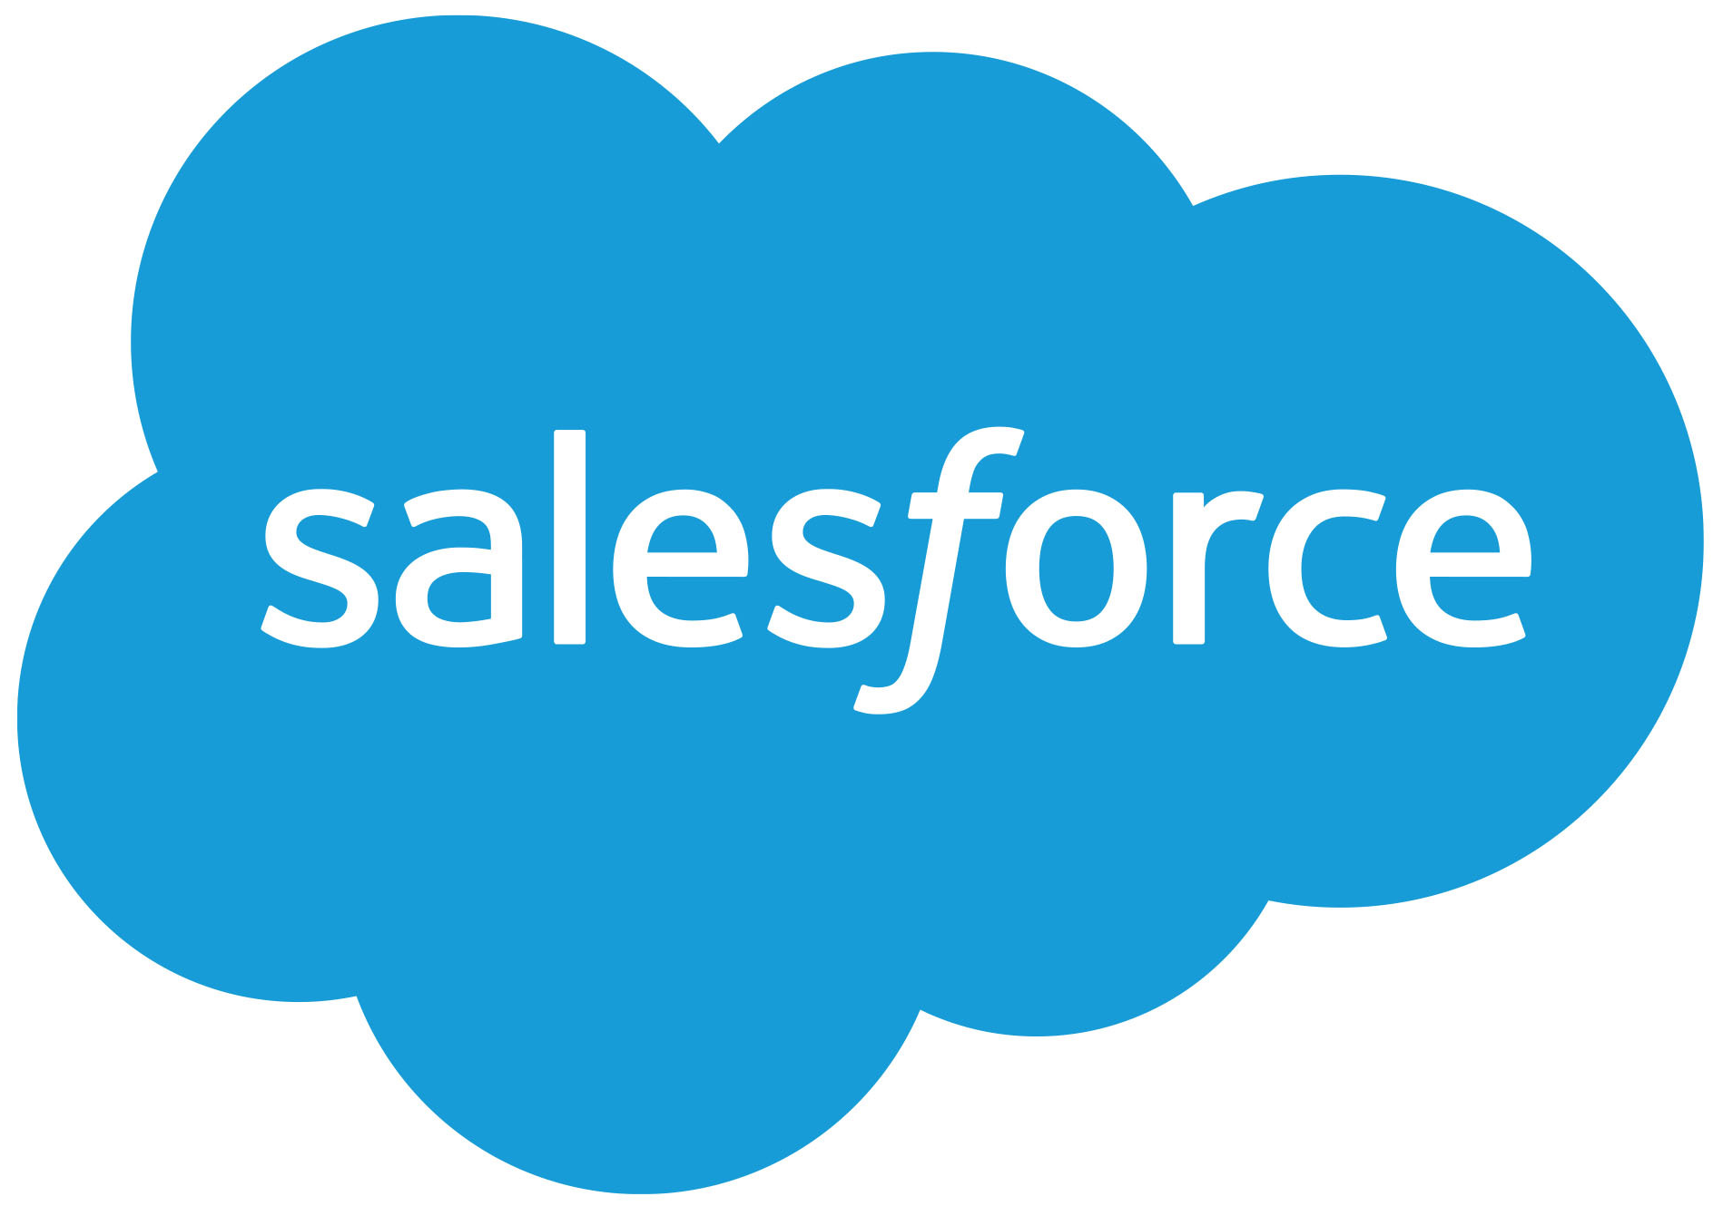
Benefits of Premium Licencing
Power Platform
Unlimited app development
↑ use cases
↑ user adoption
↑ ROI
Access to Premium connectors
Improved performance

Slide 14
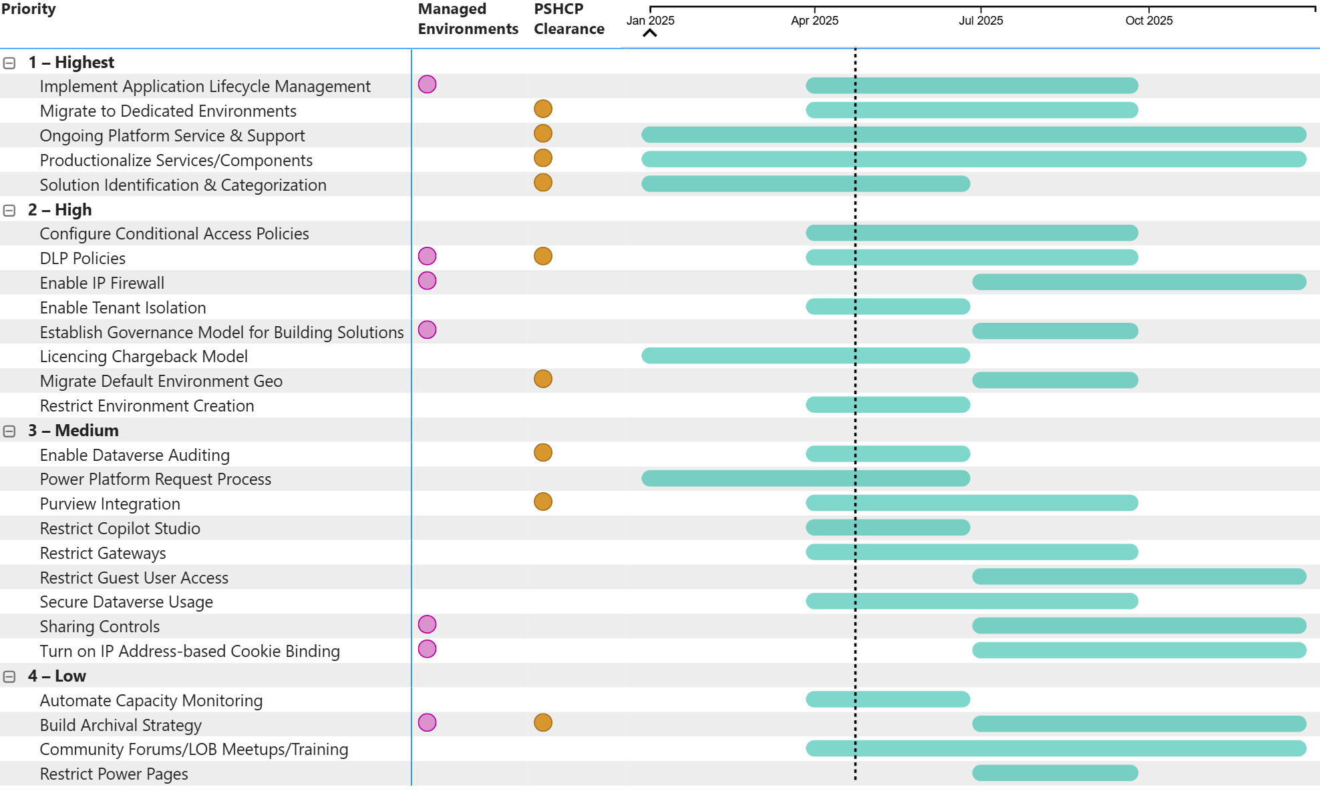
Power Platform
Roadmap
Notes:
Roadmap of main items by priority
Organized by quarter
Managed req & PSHCP req
Review Highest & High next

Slide 15
Power Platform
Priority Items (1 of 5)
Activity | Priority/Category | Description
Solution Identification & Categorization | 1 - Highest Environment Strategy | Meet with makers to classify components (ex. flows, apps) according to LOB, criticality, data sensitivity, connectors, etc. Identify which components need to be moved to which environments. A mapping document should be created for this to track moves and business reasons for the move.
Migrate to Dedicated Environments | 1 - Highest Environment Strategy | Develop a detailed transition plan that outlines the steps required to move from the current environment setup to the new strategy. This should include timelines, resource allocation, and communication plans. Use the Power Platform Admin Centre to create new environments based on the new strategy. Follow the naming convention "Name-Environment Type-Geography" for each environment. Export existing solutions from the current environments. This can be done using the solutions feature in Power Platform, which allows you to package and move components together. Import the exported solutions into the new environments. Ensure that all dependencies are addressed and that the solutions function as expected in the new environments. Offer training sessions for users to familiarize them with the new environment setup.

Slide 16
Power Platform
Priority Items (2 of 5)
Activity | Priority/Category | Description
Implement Application Lifecycle Management | 1 - Highest Environment Strategy | Prioritize ALM Integration for High Valued Environments. Implement Power Platform Pipelines to achieve a secure and automated ALM process, improving deployment efficiency, ensuring version control, and enabling scalable and compliant solution deployments across multiple environments. Conduct training for App makers on understanding the Solution packaging (Import/Export) and using Pipelines for automating the deployment process, considering post-deployment steps for an environment.
Ongoing Platform Service & Support | 1 - Highest Support | KTLO & future enhancements
Productionalize Services/Components | 1 - Highest Operations | T2P APM Documentation standards/templates Document best practices and training areas to ensure consistent and effective use of the Power Platform

Slide 17
Power Platform
Priority Items (3 of 5)
Activity | Priority/Category | Description
Enable Tenant Isolation | 2 - High Access Security | Turning on tenant isolation for all environments in Power Platform helps ensure that data within your tenant is protected from unauthorized access by users from other tenants. Enable Tenant Isolation through admin centre, under the Policies section. Configure the allowlist to specify which external tenants are permitted to establish connections with the Canada Life tenant. Specify the tenants allowed for inbound, outbound, or both types of connections. Use the special pattern “*” to allow all tenants in a specific direction when tenant isolation is turned on. Monitor and Adjust: Regularly monitor the tenant isolation settings and adjust the allowlist as necessary to ensure that only trusted tenants have access.
Establish Governance Model for Building Solutions | 2 - High Governance Strategy | Create a simple flow that sends an automated message via Teams and email every time a user creates either an app or a flow and requests a business justification for it, with the condition that, if no answer is received within a predefined time period, the development in question should be deactivated. Data should be collected on the type of data that is handled by the app/flow, business purpose of the development, intended audience, data sources, etc.

Slide 18
Power Platform
Priority Items (4 of 5)
Activity | Priority/Category | Description
Configure Conditional Access Policies | 2 - High Access Security | Conditional Access Policies were formally configured for Microsoft 365, but a deep-dive on the Power Platform side (ex. including Dataverse) was never done. A complete analysis and testing of CA Policies needs to be performed, including trusted/untrusted devices, different Operating Systems, etc.
Enable IP Firewall | 2 - High Access Security | Key benefits are mitigating insider threats like data exfiltration (i.e. a malicious user who tries to download data from Dataverse using a client tool like Excel). Enable IP Firewall though the settings for a selected environment. Specify the allowed IP ranges. For multiple IP ranges, separate them with a comma. Monitor and Adjust: Regularly monitor the IP firewall settings and adjust the allowed IP ranges as needed to ensure that only trusted IP addresses have access.
Licencing Chargeback Model | 2 - High Financial Management | To ensure the viability of the platform in future, we need to establish a clear, enforceable chargeback model to cover licencing and support costs.

Slide 19
Power Platform
Priority Items (5 of 5)
Activity | Priority/Category | Description
Migrate Default Environment Geo | 2 - High Risk Management | Current Default environment resides in the United States, so a migration to Canada is necessary for compliance reasons. Prior to migrating the Default environment, other activities need to complete including: Solution Identification & Categorization Migrate to Dedicated Environments
DLP Policies | 2 - High Risk Management | Implement DLP policies to protect sensitive data. Configure policies beyond existing ones to cover Developer, Teams, and new environments. Configure policies to apply to Power Automate Desktop.
Restrict Environment Creation | 2 - High Environment Strategy | Restrict creation for all environment types to Power Platform admins.

